Slide 1

Cool Currents: Navigating July's Energy Peaks with Sustainable Solutions
Team Members
Soundarya Ravi
Archit Dilip Dukhande
Aditya Sanjay Pawar
Subhiksha Murugesan
Rithvik Rangaraj

Slide 2
Problem Statement
Objective: To understand and influence residential energy usage patterns, avoiding the need for new power plant construction.
Goal: To reduce energy consumption during peak periods, ensuring reliable supply and aiding environmental sustainability, without expanding infrastructure.

Slide 3
Mission At eSC
Insight Unveiling
Our exploratory data analysis will uncover key patterns, exposing the driving forces behind energy consumption. The goal? Crafting precise predictive models for hour-by-hour energy forecasts in July, rigorously tested for accuracy
Heat Up the Scenario
Concerned about soaring temperatures? We'll crank it up by simulating a 5-degree Celsius spike in July. This lets us predict peak energy demands across different regions, factoring in various influences
User-Friendly Tools
Say hello to our Shiny application! This intuitive tool will streamline data navigation, playing a pivotal role in shaping a data-driven strategy to tame peak energy demands.

Slide 4
Business Questions
What approach should be taken to build predictive models capable of accurately estimating energy usage for each hour in July?
How will we evaluate and compare the performance of different models to select the most accurate one?
What features and functionalities should be incorporated into the Shiny application to facilitate user-friendly interaction with the energy data?
How can we ensure the application meets the specific needs and preferences of our client?
What considerations are essential to ensure the modified dataset aligns with realistic scenarios?
What potential approach was identified to reduce peak energy demand, and how was this approach derived from the data?
How would the impact of this approach be modeled, and what data-driven explanations would be provided to stakeholders regarding its effectiveness?
What is the most effective way to communicate and explain the impact of the strategy to stakeholders in a clear and understandable manner?

Slide 5
Approach
Data Cleaning: Scrutinize and refine the data to ensure accuracy, consistency, and completeness.
Data Merging: Combine multiple datasets into a single, comprehensive dataset for analysis.
Exploratory Data Analysis: Conduct initial investigations on the data to discover patterns, spot anomalies, and test hypotheses.
Model Building: Develop predictive models using the cleaned and merged data to understand key factors affecting energy usage.
Shiny App Development: Create an interactive web application using Shiny to visualize the data and model outcomes.
Key Actionable Insights: Extract and highlight the most important findings from the analysis to inform strategic decision-making.

Slide 6
Data Cleaning and Munging
Removed NANs.
Dealing with negative values.
Reduced Columns.
Extracted the relevant month July data.
Converted the 24 time line into 6 section of the day.
Generated a new columns for Weather with 5 degree warmer to test the model.

Slide 7
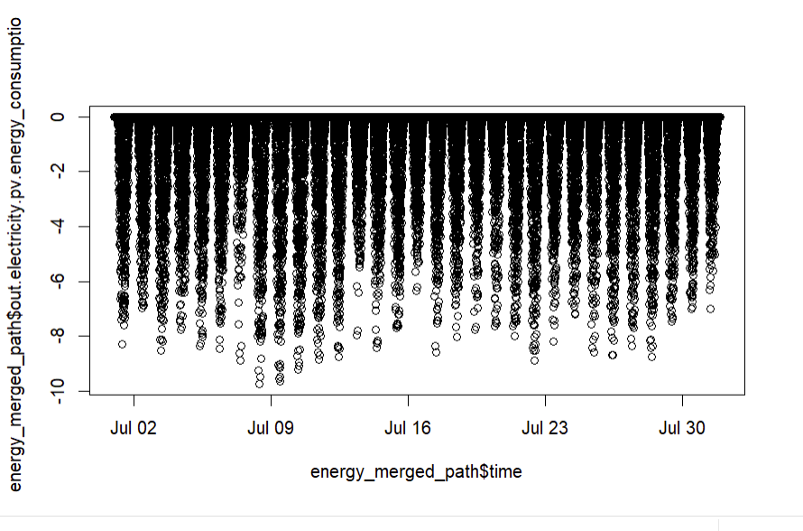
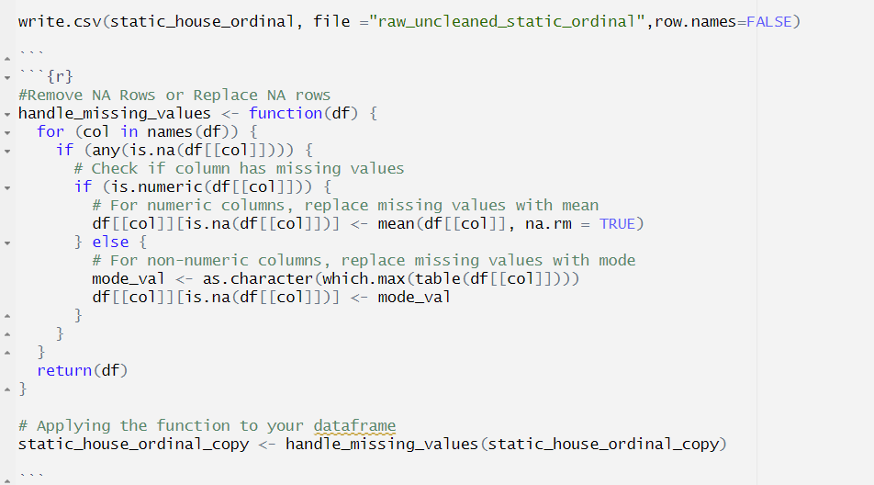
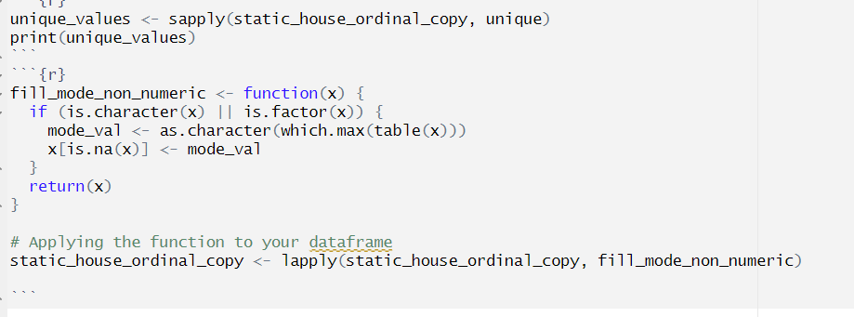
Negative Values in the Energy?

Slide 8
Exploratory Data Analysis
Plotted distributions to analyse trends
Generated correlation heatmaps for while performing feature engineering.
Boxplot of energy consumption by day to determine when most energy was used.

Slide 9
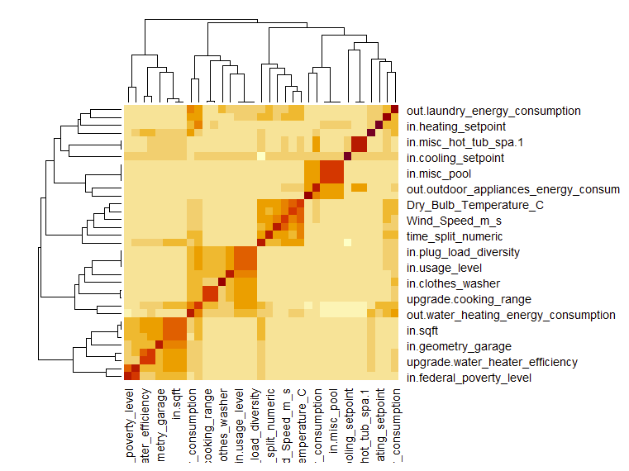
Exploratory Data Analysis

Slide 10
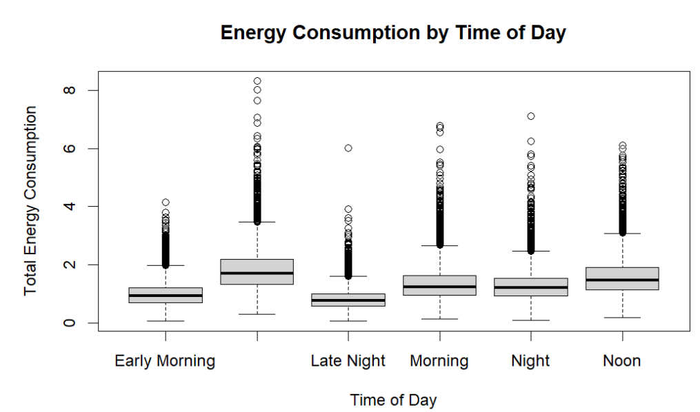
Exploratory Data Analysis

Slide 11
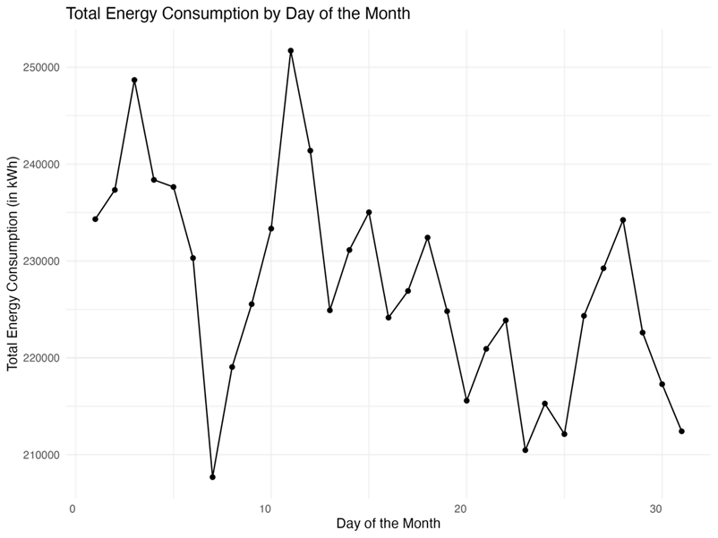

Slide 12
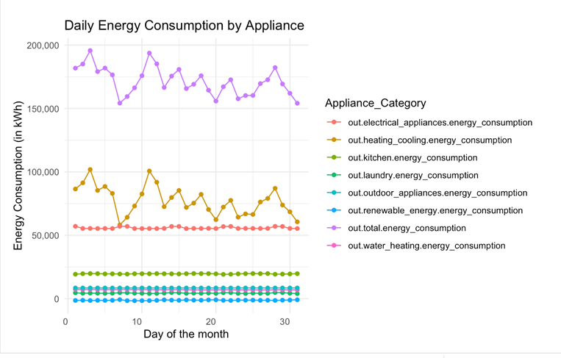
Daily Energy Consumption

Slide 13
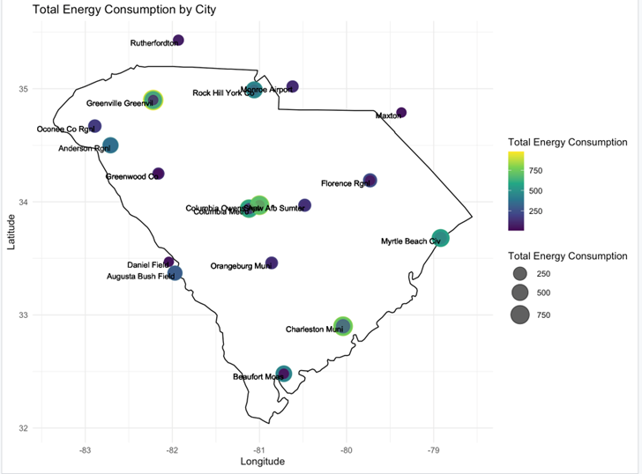
Map Visualization

Slide 14
Models
Linear Multiple Regression
69.7% Adjusted R Square
MAPE: 24.9
SVM
MAPE: 12.86%
XGBoost
85.7% Adjusted R square
MAPE:15.22%

Slide 15
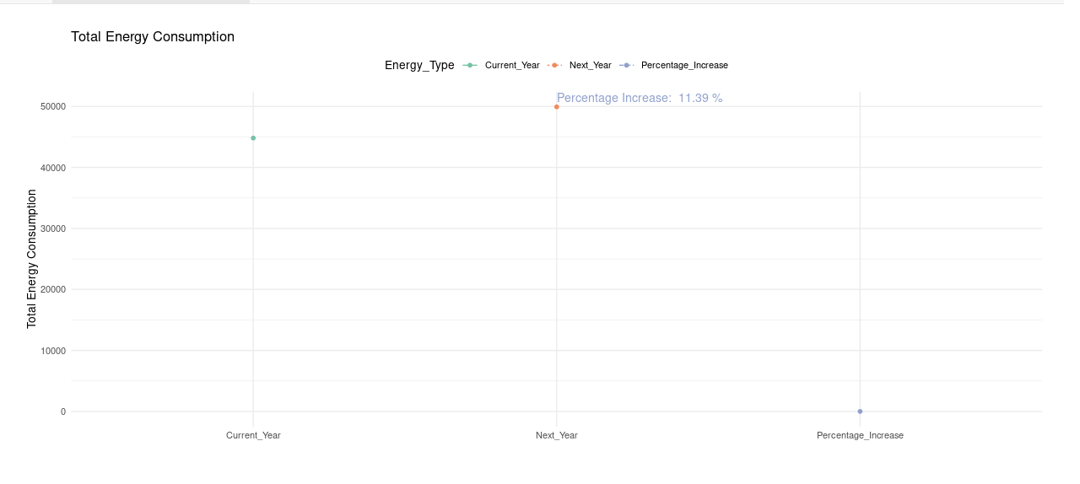
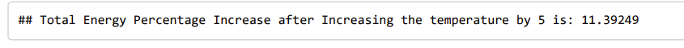
What We Found out?

Slide 16
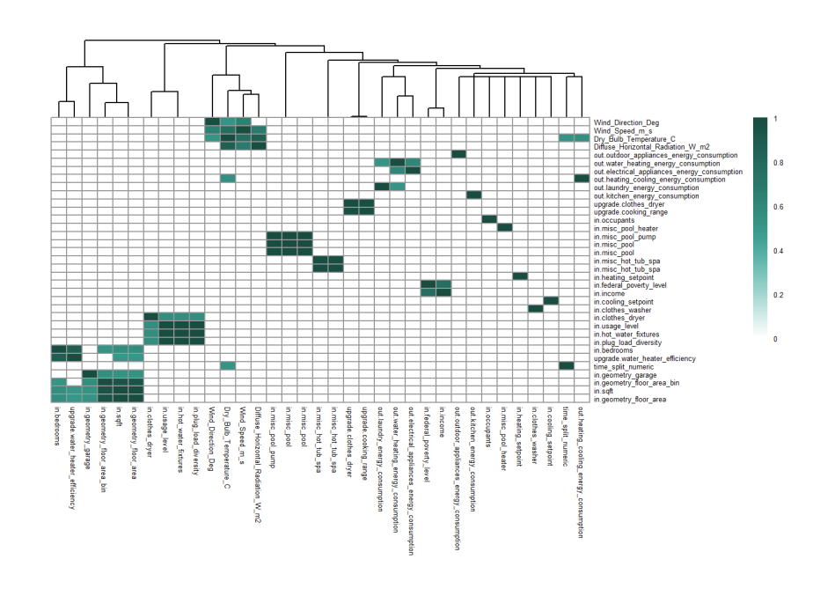

Slide 17
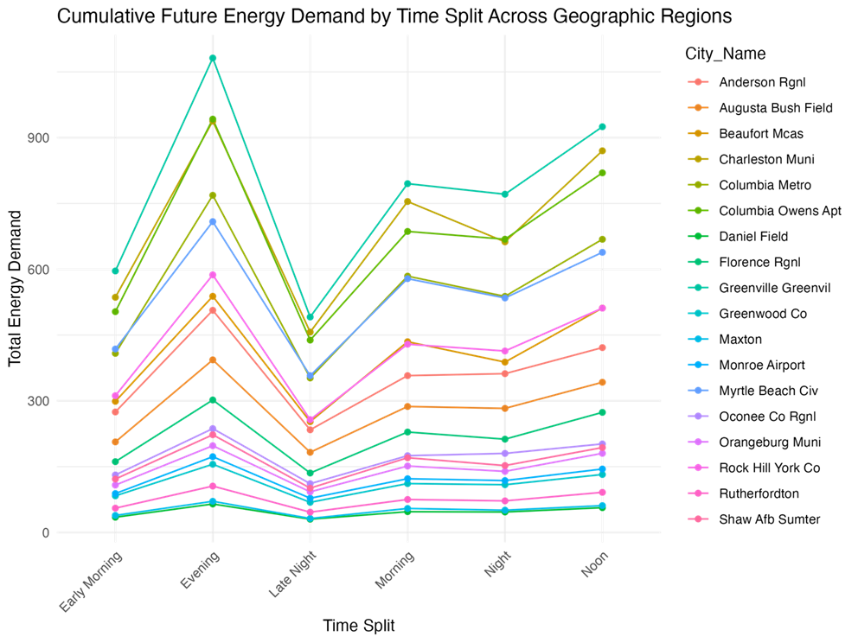
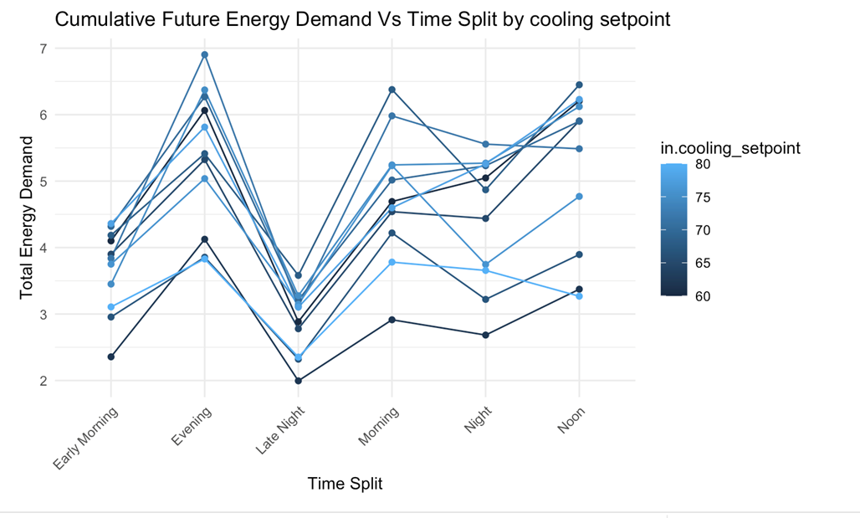
Other Key Visualizations

Slide 18
Actionable Insights
Identified Energy Consumption Patterns:
Predominant energy consumers: heating/cooling systems. July activity highlights climate impact. Focus on systems for effective energy management.
Proposed Solution - HVAC Cooling Efficiency Modification:
Ten distinct HVAC cooling efficiency types were identified, ranging from high to low efficiency, with SEER ratings and EER values providing insights into energy performance.
Proactive Approach for Sustainable Energy Practices: Aims to contribute to a more resilient and environmentally conscious energy infrastructure, reflecting a commitment to sustainable energy practices.

Slide 19
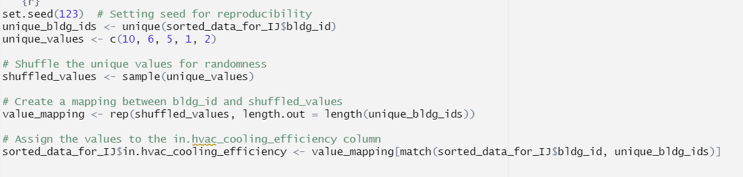
"Revolutionizing Energy Efficiency: Turbocharge Your HVAC! 🌬️ Explore the Top 5 High-Efficiency Cooling Systems and Unleash Savings on Total Energy Consumption! 🌐💡 #SmartCooling #EnergySavings"

Slide 20
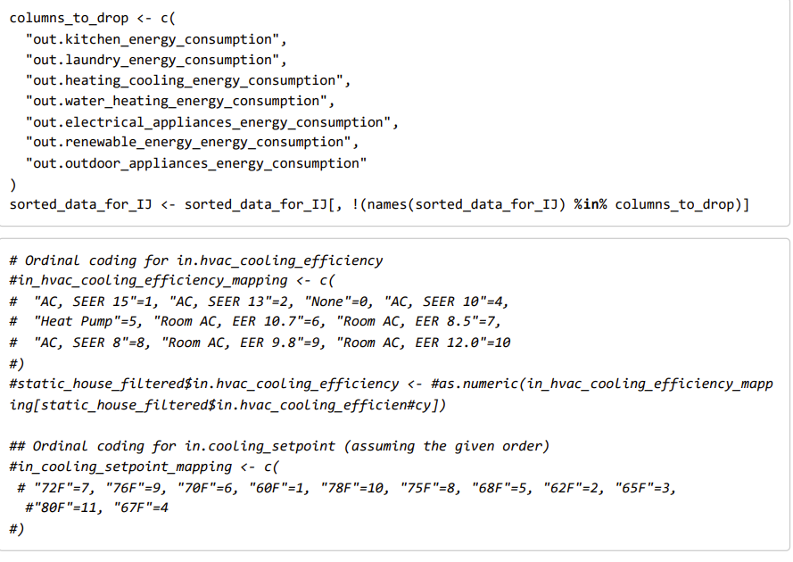
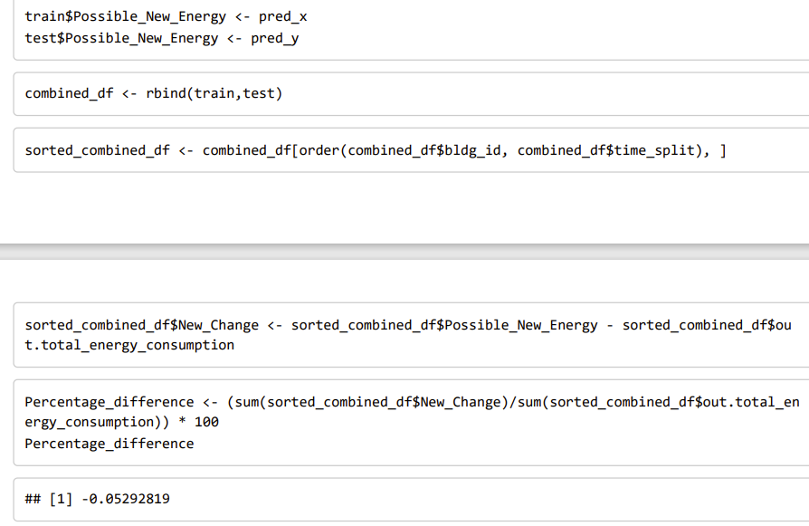
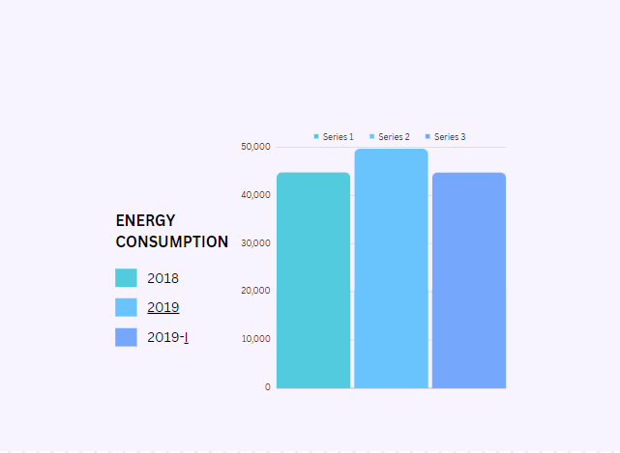

Slide 21
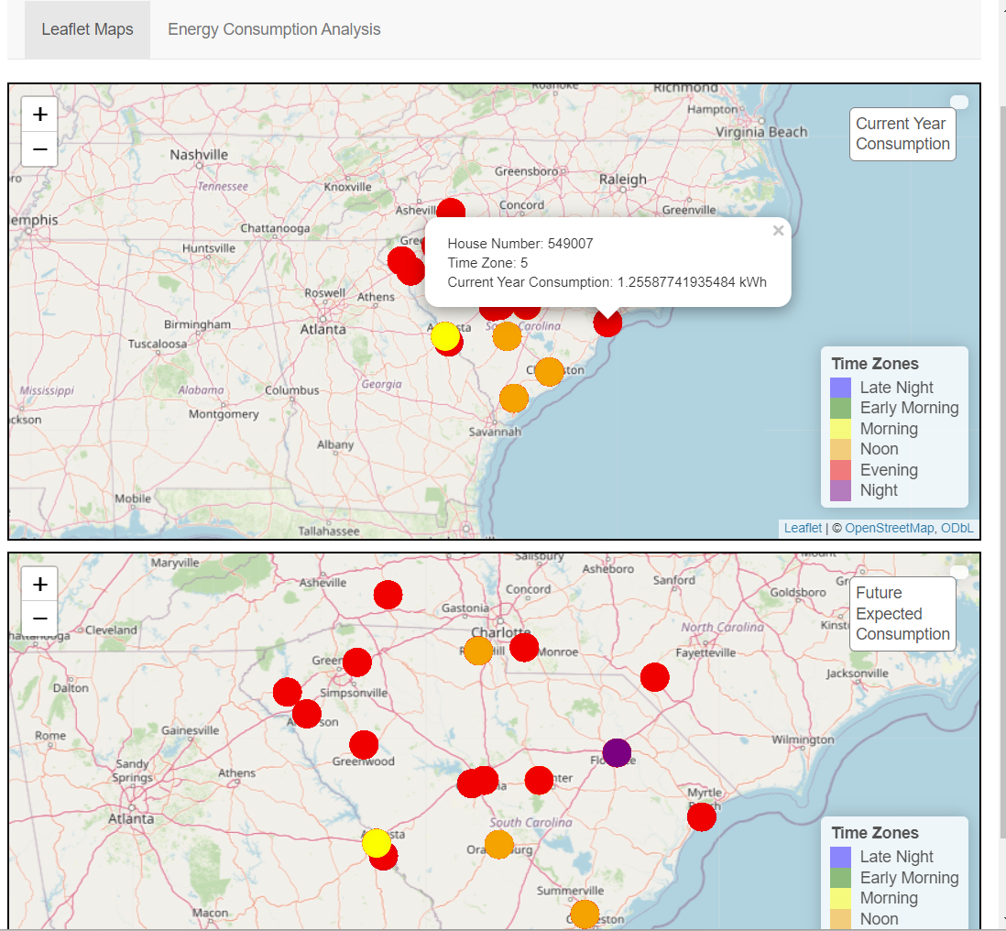
Shiny App URL: https://soundaryaravir.shinyapps.io/eSCApp/

